Slide 1

Big Mountain Resort
Ticket price market analysis

Slide 2
Mission
Big Mountain made a great financial/business investment in a new lift, increasing this year’s costs by ~$1.54 million
Our data science team was brought on to help inform financially efficient changes and locate avenues for cost cutting
  We sought to accomplish this without undermining current ticket pricing
We use data from market competitors to figure out a ticket price increase acceptable to customers, and fair to your business.

Slide 3
Recommendation
Based on our advanced analysis of the market conditions, comparing the elite features of Big Mountain:
  Big Mountain could justifiably increase their ticket price from $81.00 to $95.87
  This estimate assumes that no further enhancements are made.
However, we do recommend the following enhancements:
  Adding a run, increasing the highest vertical drop by 150 feet, and installing an additional chair lift.
    This scenario increases support for ticket price by $8.61.
    Over the season, this could be expected to amount to $15.0 million in increased revenue.
  As an option, closing 5 of the least used runs would save Big Mountain on operating costs and only decrease expected ticket pricing by $0.66, equalling ~$1.2 million.

Slide 4
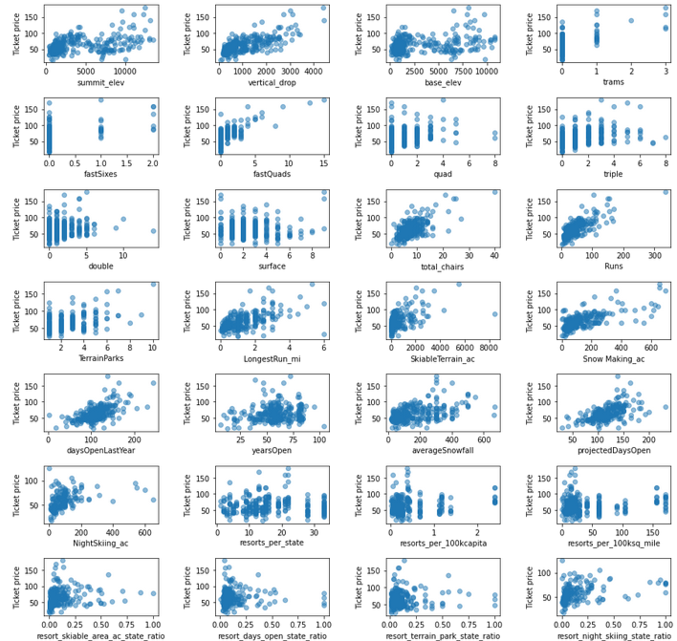
Finding Features
We conducted exploratory data analysis to narrow our data, which allowed us to form our models on the most predictive aspects of our data.
Visualizing scatter plots of various features vs. ticket price elucidated a few obvious positive correlations: vertical drop, fast quads, runs, and total chairs.

Slide 5
Modeling Results
After building differing models, then comparing for effectiveness, we decided to use a random forest model to compute proper ticket pricing.
Based on certain features which the market values, Big Mountain could justifiably increase their ticket prices to $95.87, a delta of $14.87 from the current ticket price of $81.00.
The features which most influence ticket price:
  Number of runs, vertical drop, and number of “fast quad“ lifts

Slide 6
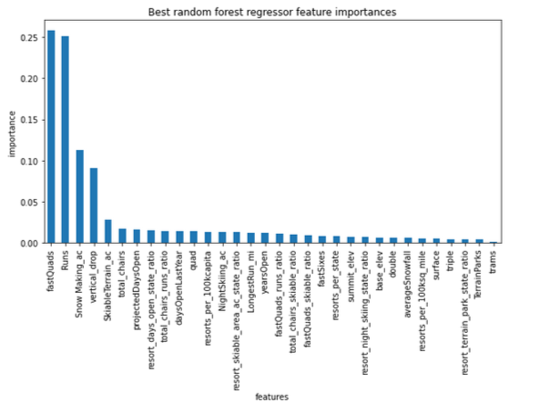
Most important features

Slide 7
Analysis
As mentioned, adding a run, increasing the highest vertical drop by 150 feet, and installing an additional chair lift would justify a ticket price increase of $8.61.
  Over the season, this could be expected to amount to $15.0 million in increased revenue.
A secondary option would be to do that, plus add 2 acres of snow making capability.
  This scenario increases support for ticket price by $9.90. Over the season, this could be expected to amount to $17.3 million in increased revenue.

Slide 8
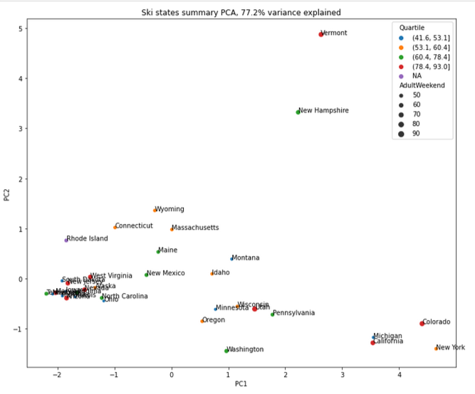
Analysis
A third option that we explored was increasing the longest run by 0.2 miles and guaranteeing its snow coverage by adding 4 acres of snow making capability.
  Option was discarded ; no modeled effect on ticket pricing
An interstate analysis of ticket price and the features of resorts demonstrated to us that there were no clear state groupings, so there were no adjustments for population or regional geography

Slide 9
Conclusion
The option to add a run, increase the highest vertical drop by 150 feet, and install an additional chair lift, became our recommendation beacause it is the most straightforward path to safeguarding your bottom line.
Even without making any changes to Big Mountain, your ticket pricing currently undervalues your premier resort by over $14 per ticket.
In order to recoup the costs of the new $1.54 million lift, you should increase your ticket prices for this season, and plan to make the recommended modifications to your property.
Advertising the new lift and the additional planned changes may help assuage price-conscious customers.

